Slide 1

Research Lightening Talk: Cx & Mx Ad Perceptions
JAN 2026
KELLY PETERSON

Slide 2
How do Cx feel about ads?
Source materials:
Cx Ad Perceptions
Exploring New Ad Formats

Slide 3
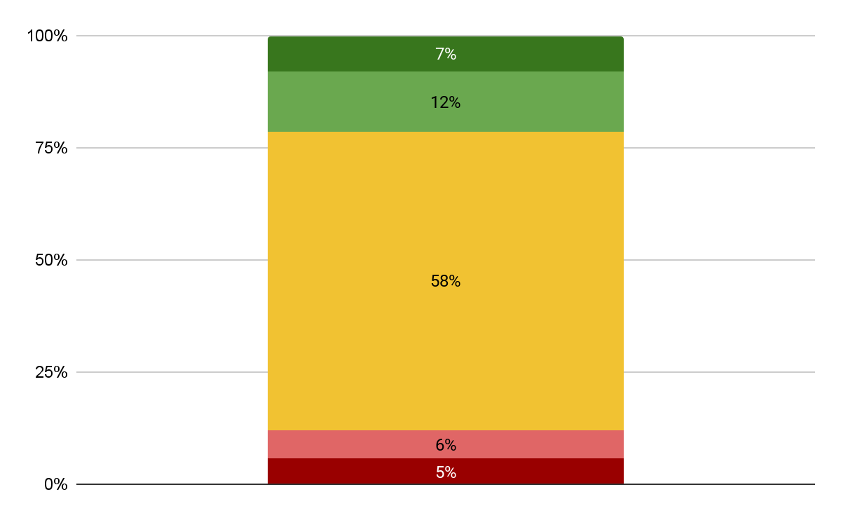


The majority of Cx feel neutral about ads on DoorDash today; they are mostly helpful to find deals
How do you feel about advertisements on DoorDash?
The most helpful/meaningful advertisements on DoorDash…
Highlight a great deal or promo
Feature a restaurant I’ve ordered from before
Introduces me to something new
Very positive
Very negative

Slide 4
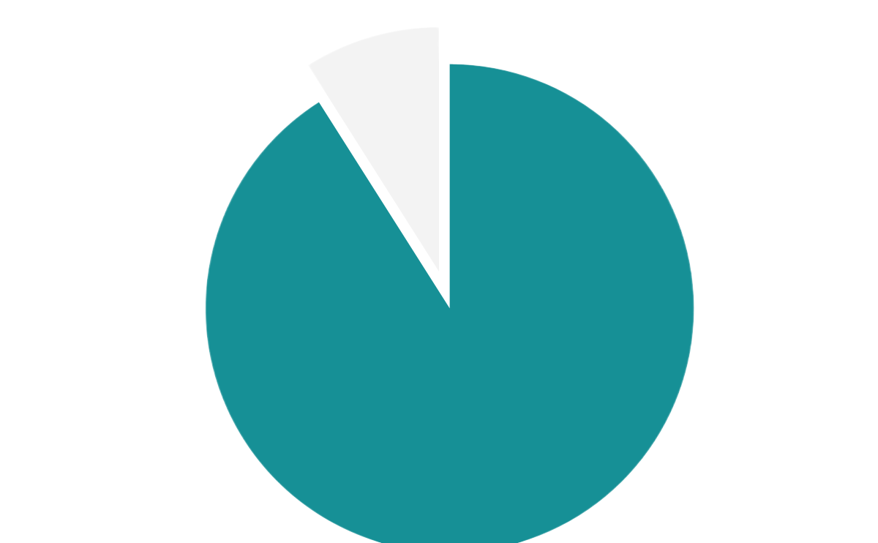

Almost all Cx have lost trust in a platform or brand due to an ad at some point
Cx typically lose trust in a brand/platform when an ad
Looks like fake content/click bait
Feels like it is tracking me too closely
Promoted a poorly rated product or place
Not relevant to me at all
Appears where I don’t expect to see it
91% of Cx have experienced an ad that “broke their trust”

Slide 5
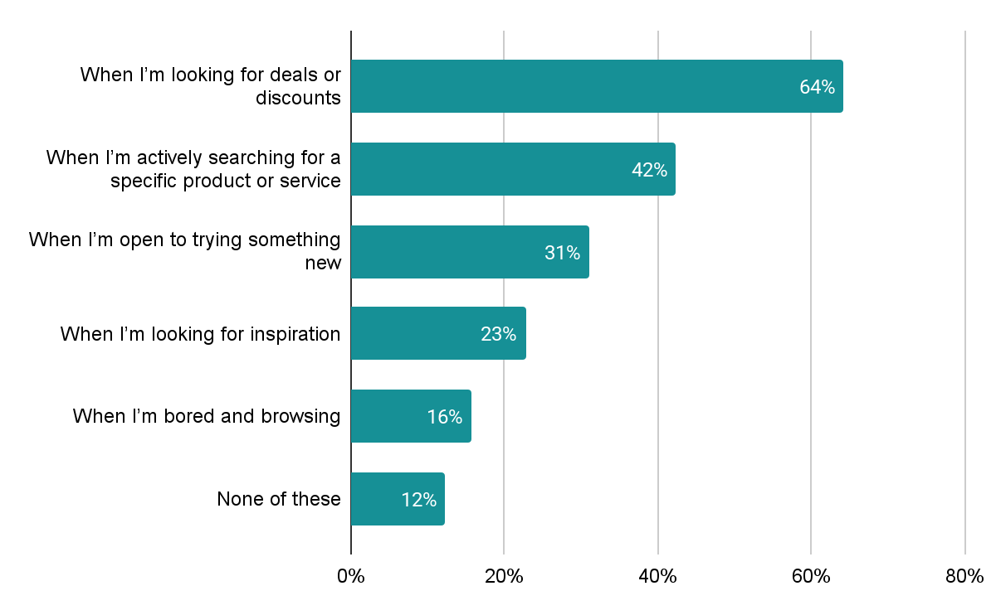



In which situations are you more likely to be open to ads?
Cx find the most value when ad placements are aligned to session intent
Which platforms have ads that you generally find helpful or meaningful?
1.
2.
3.

Slide 6

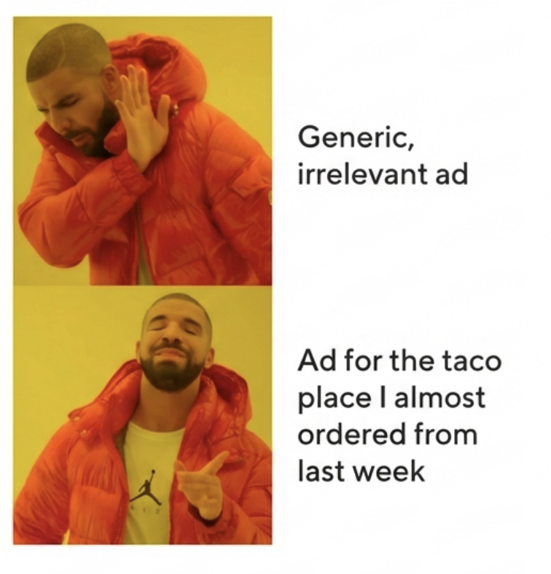
This is true on DoorDash as well
Relevance is Non-Negotiable
Customers are highly selective. They only notice ads that align with their order history or current cravings.
The Blind Spot: Generic ads are mentally filtered out immediately.
•
The Hook: A user who orders Sushi is far more likely to notice a Poke bowl ad than a Taco promo.
•

Slide 7
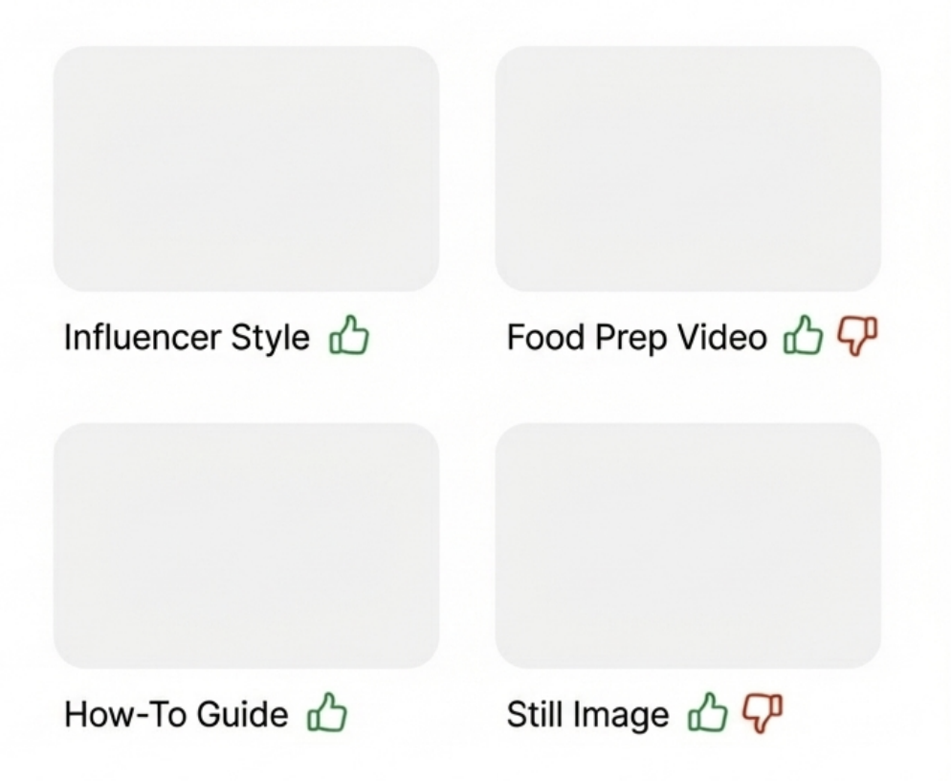
Personalization isn’t just what you show, but how you show it
Customers have very strong opinions on which formats work and do not work for them
Cx have strong likes and dislikes across influencer style videos, food videos, how to videos, and still images vs. videos
•
•

Slide 8


Ads create friction when they are repeated too often and block Cx from completing their task
What makes an ad feel intrusive or bothersome?
“
 | 1 | It repeats too often
 | 2 | It’s too long or hard to skip
 | 3 | It interrupts what I was doing
 | 4 | It feels manipulative or dishonest
 | 5 | It’s irrelevant to me
 | 6 | It comes from a brand I don’t trust
Repeating the same ad constantly. I just saw that ad, and then I just see it again. Two scrolls down, or if I'm on a webpage, I see it on the top, and then I see it again at the bottom. Same ad. Like an ad that's repetitive too much.
”

Slide 9
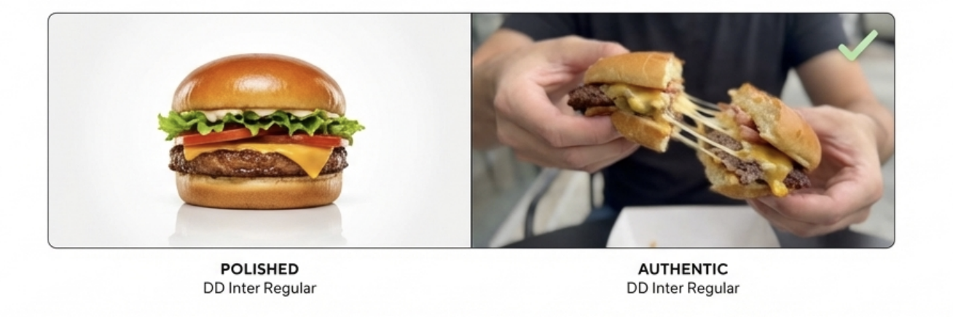
Instead- authenticity builds trust
Real vs. Produced
The Authenticity Trap
Videos showing food actually being mixed, held, or eaten (influencer style) performed better than polished TV-style commercials.
However, balance is key. If it feels too much like social media ("Instagram-itis"), it becomes distracting and feels out of place in a utility app.

Slide 10
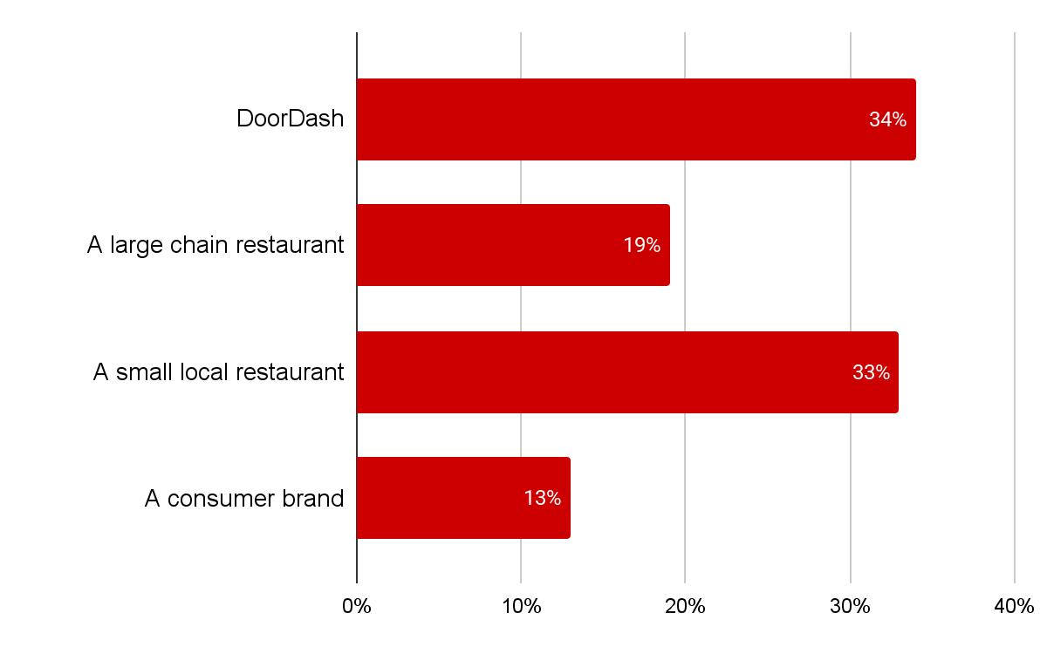
While Cx say they are not largely impacted by the source of an ad, SMBs garner greater trust than ENT or CPG when it comes to ads
Which of the following sources would you trust the most?
12%
of Cx indicated that the source of the ad impacts their perception of an ad “a lot” or “completely changes their opinion”

Slide 11

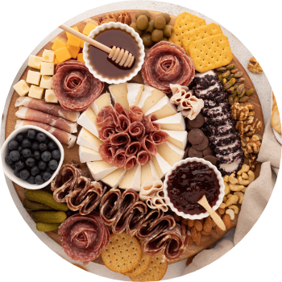
Utility provides relevance
Teaches or Inspires
Content that functions as a tool is not perceived as an annoyance.
•
Example: "How-to" guides (e.g., Charcuterie board assembly).
•
Example: Recipe ideas (e.g., Creative uses for Ritz crackers).
This shifts the perception from "Demanding a purchase" to “giving inspiration”
This is particularly true for CPG/NV products

Slide 12

Those that do recall seeing deals or emails; however, some ad recalls are not actually advertisements at all.
What advertisements have you seen on DoorDash recently?
Deals, discounts or coupons
Emails & push notifications
Grocery or convenience store ads (for the vertical as well as for stores)
Sponsored restaurants and search placement
Home carousels (e.g. recommended for you)
Local/new restaurants
DoorDash services (e.g. DashPass)
Cart add ons (Doubledash & add to your cart)

Slide 13
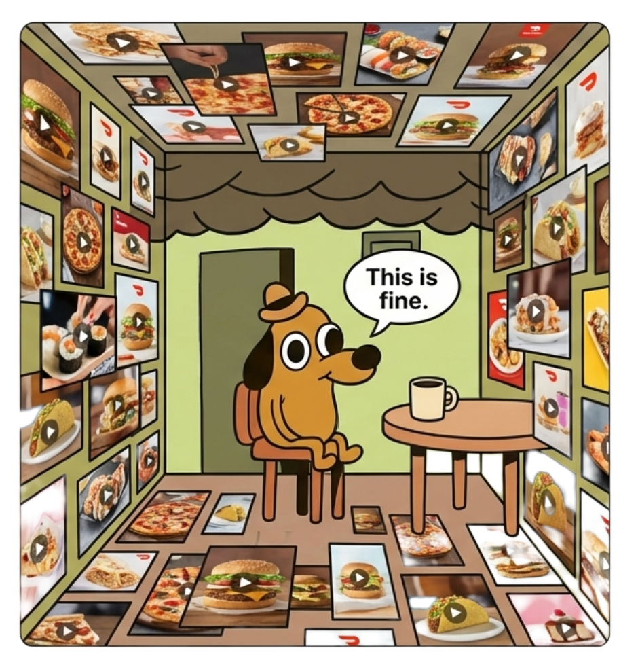
Too much clutter creates “instagram-itis”
A major complaint was that too many videos or advertisements make the app feel cluttered busy or hectic,
The movement of the videos was distracting, especially when looking for a specific restaurant, cuisine or item.
•
•

Slide 14
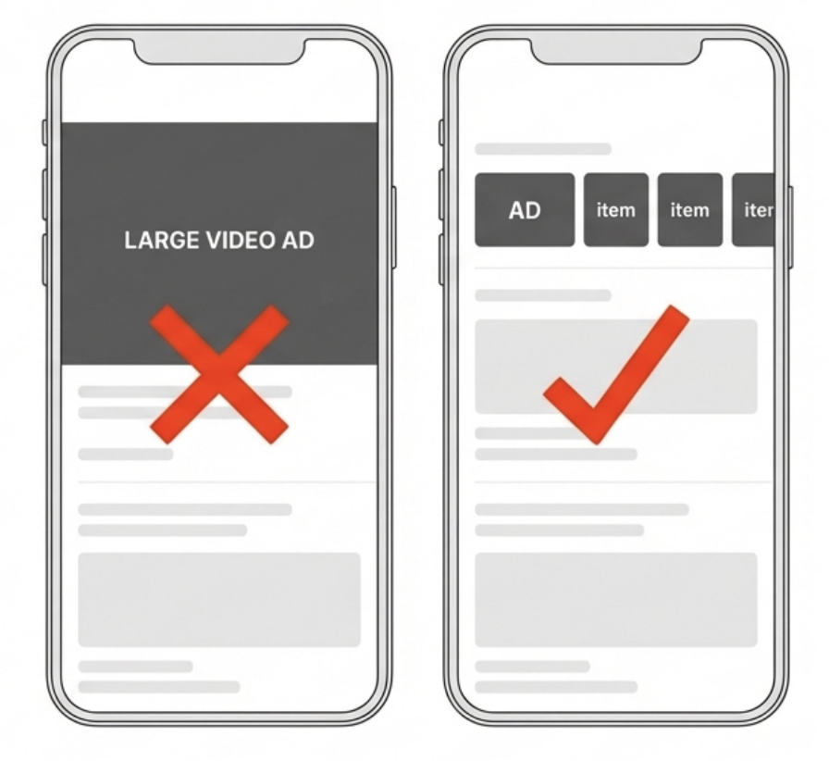
Bigger is not always better
Large videos that take up significant real estate feel intrusive
•
•

Slide 15
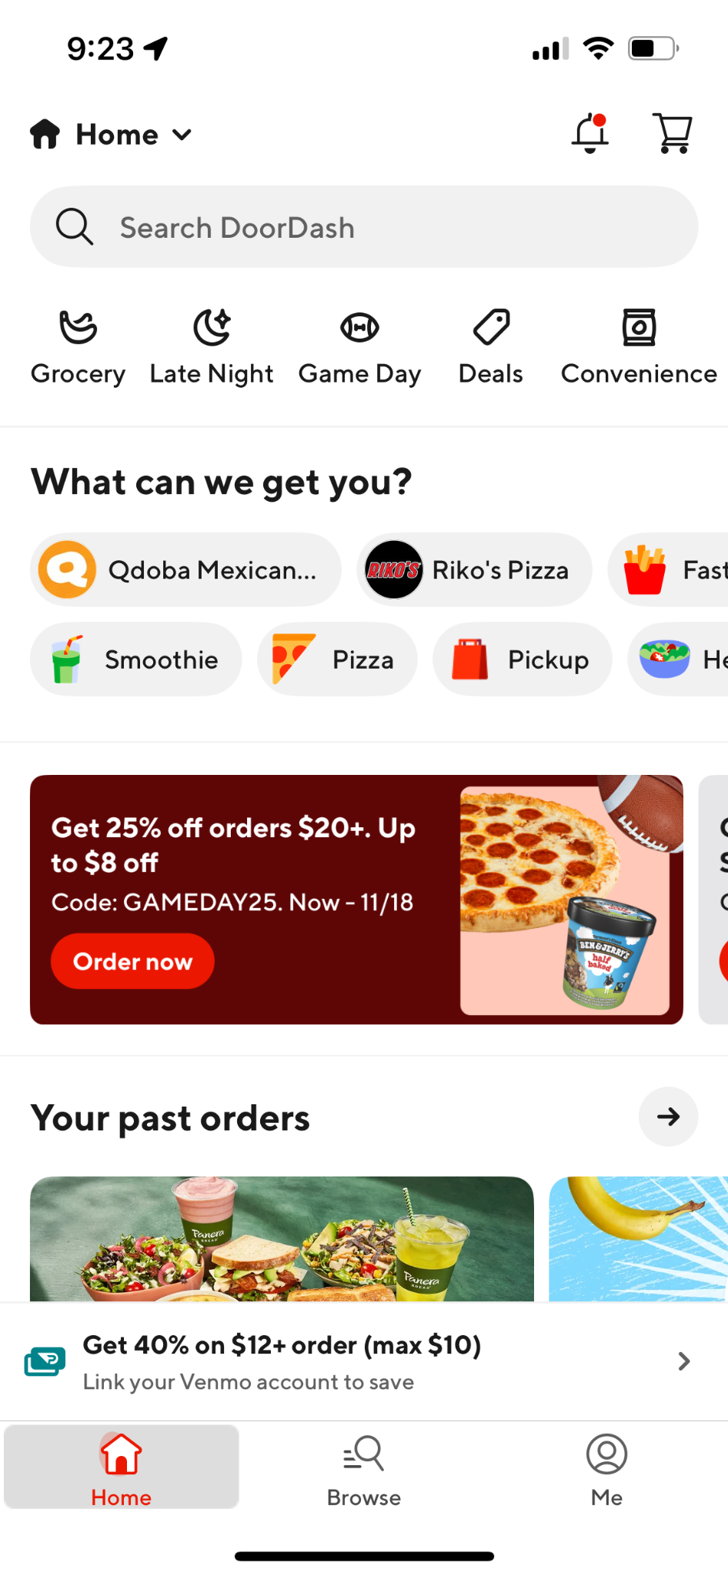
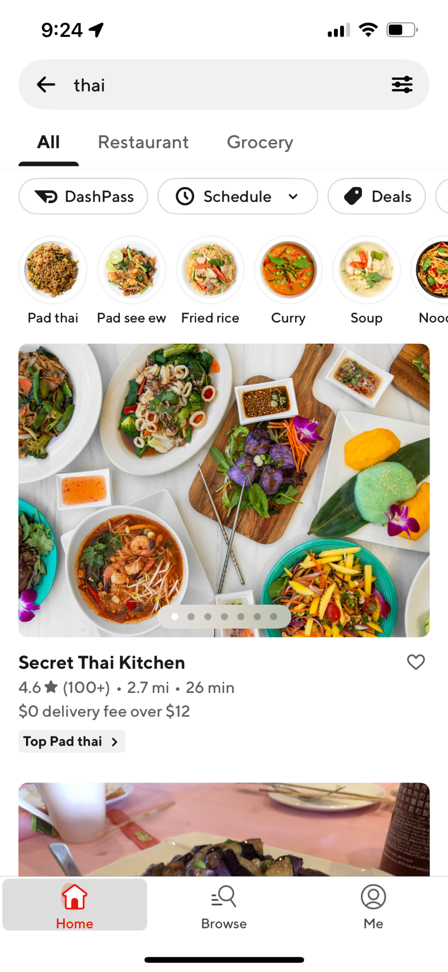
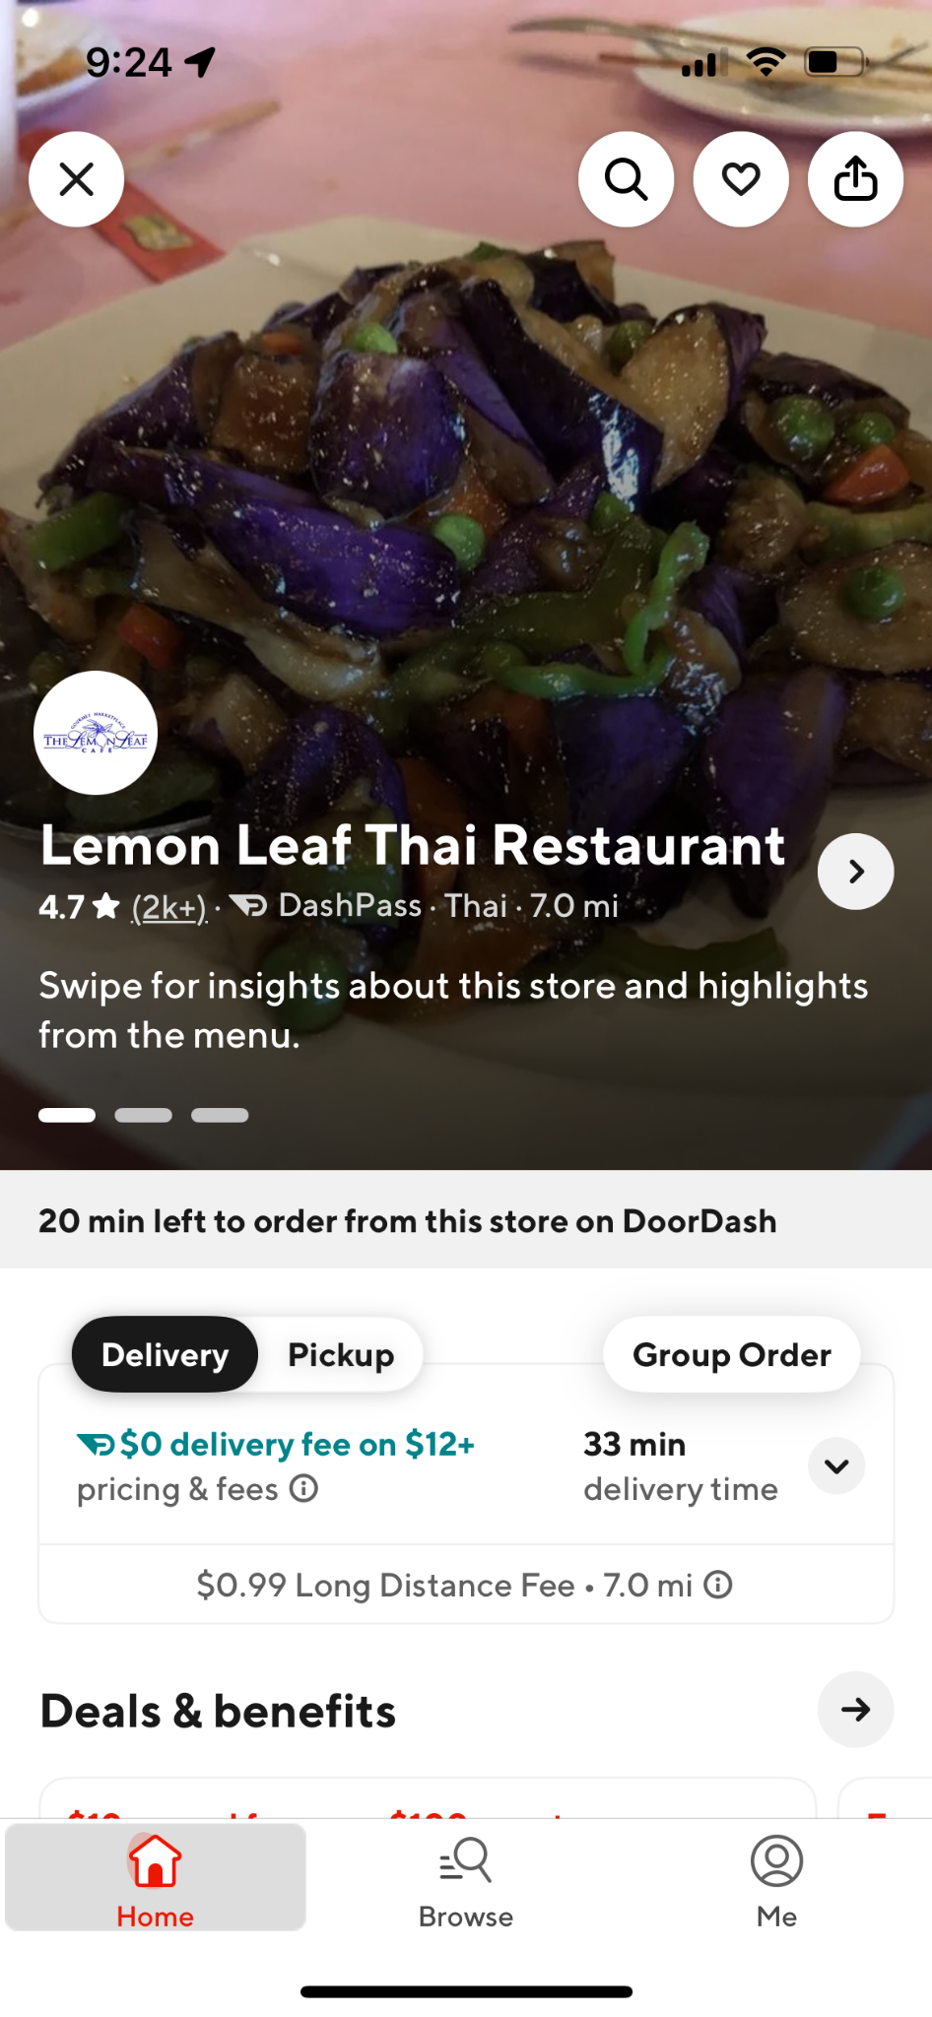
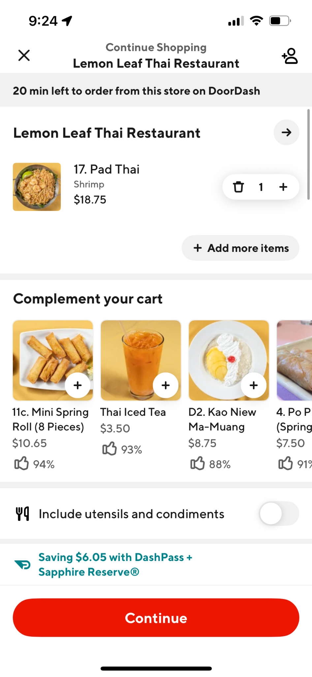
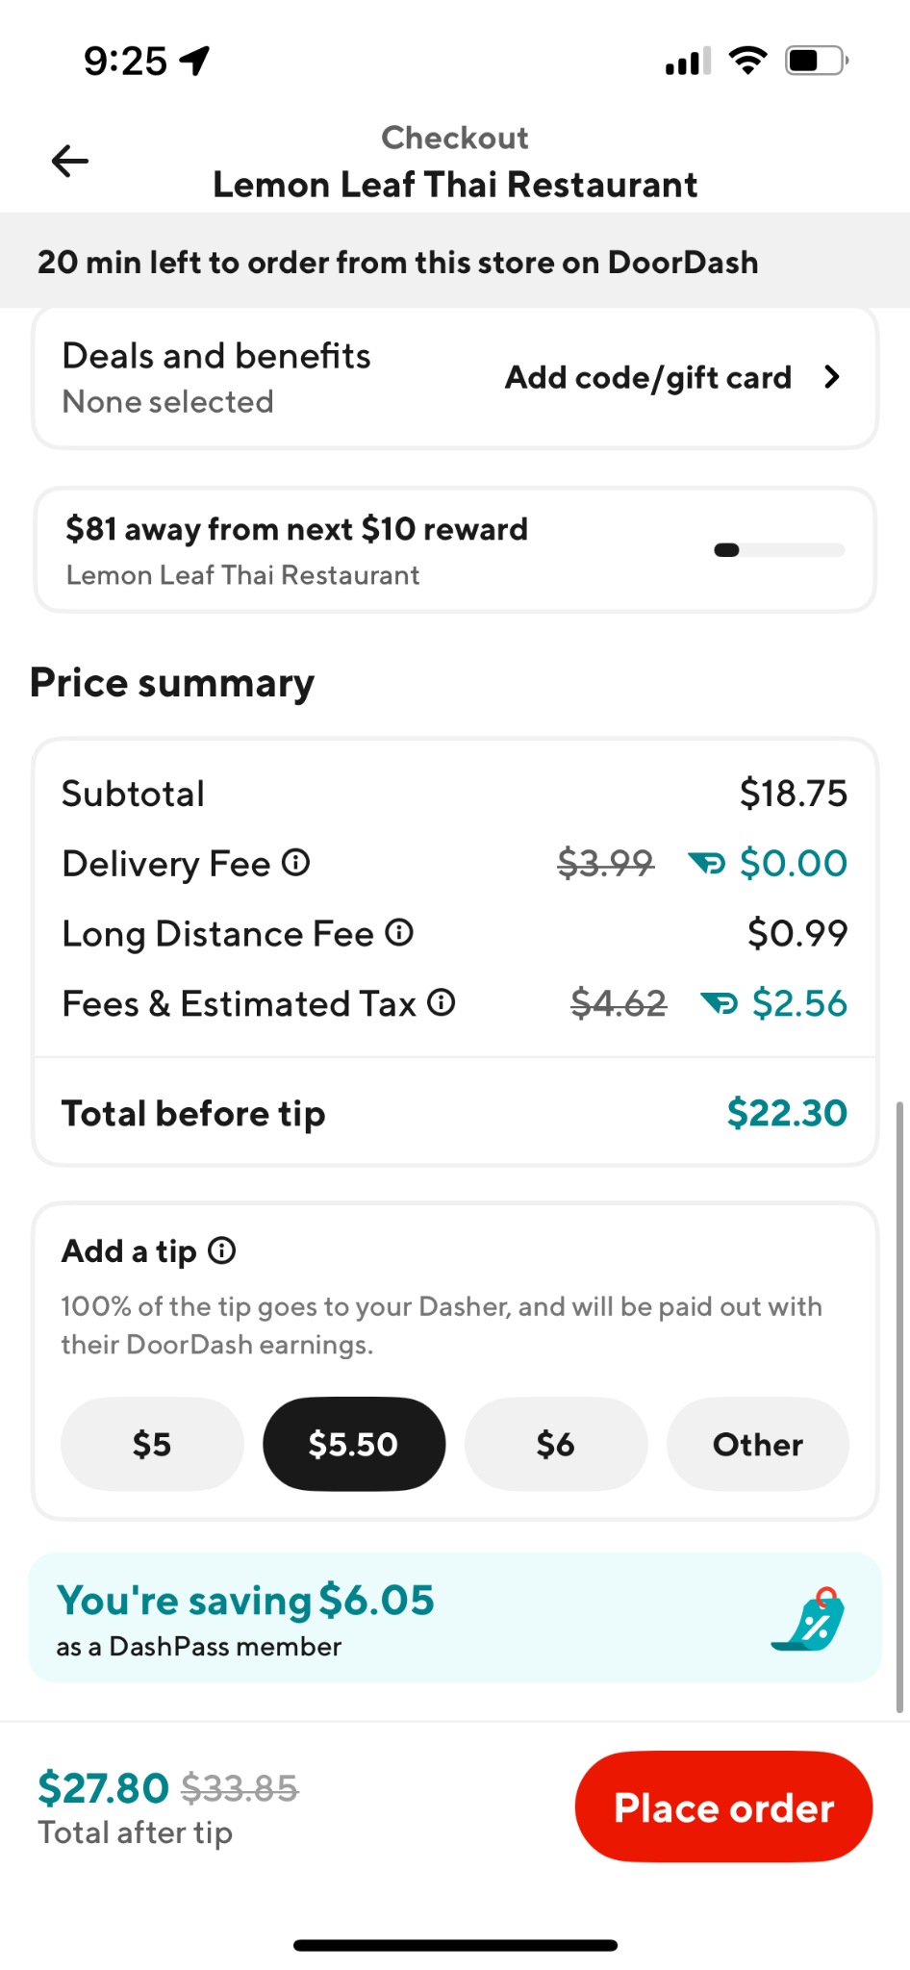
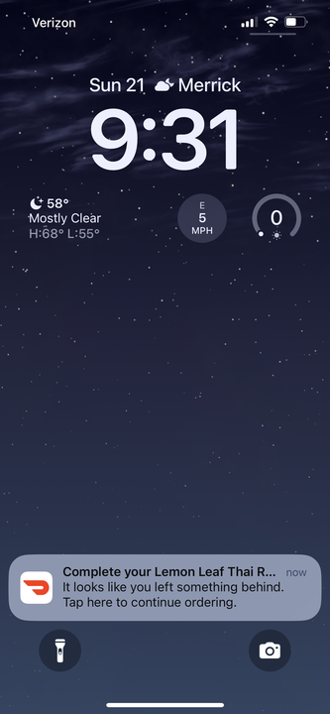
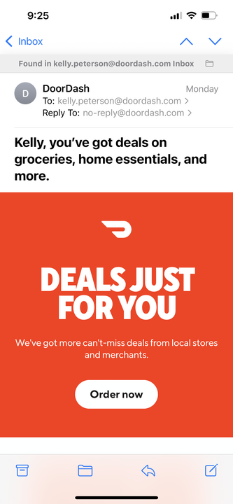

Cx expect to see ads top of funnel; later in the ordering process becomes too intrusive
Homepage | Search | Storepage | Checkout | Post-checkout | Push notifications | Email
✅ | ✅ | ✅ |  |  |  | Proceed with caution

Slide 16
Recommended Design Principles
1. Intent-First. Ads should align with why the customer is on DoorDash (finding food, deals, discovery). Focus on promotions, new/local restaurants, and relevant NV tie-ins.
2. Helpful, Not Intrusive. Ads should feel like a service (helping save money, surface variety) rather than an interruption. Avoid formats that are long, unskippable, or block task completion.
3. Trust by Design. Keep ads transparent and clearly labeled (e.g., “Sponsored,” “Deal”). Avoid clickbait, fake-feeling content, or overuse of personal data (without explanation).
4. Light-Touch Frequency. Maintain a balance: ads should be visible but not overwhelming. Limit repetition of the same restaurant or offer to reduce fatigue.
5. Contextual Placement. Early journey: homepage, deals tab, search results, storepage → high visibility, low friction. Late journey: checkout → only lightweight that feel additive
6. Champion Local. Elevate ads for small/local businesses alongside chains to build goodwill and community trust.
7. Frictionless Flow. Ensure ads don’t disrupt the core task (ordering food quickly).

Slide 17
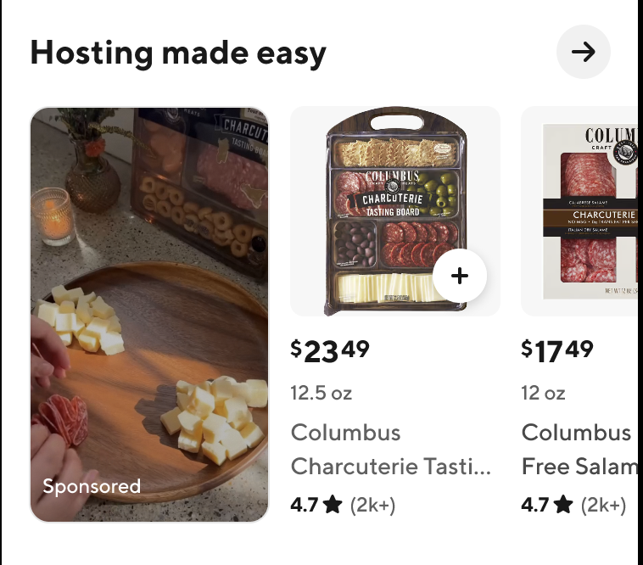
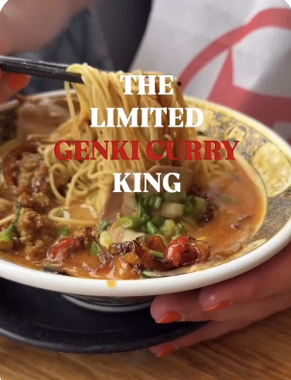
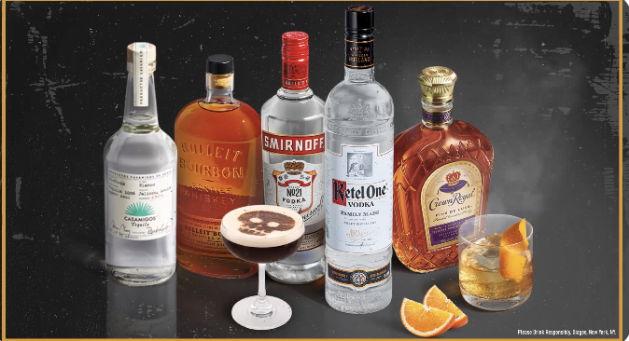
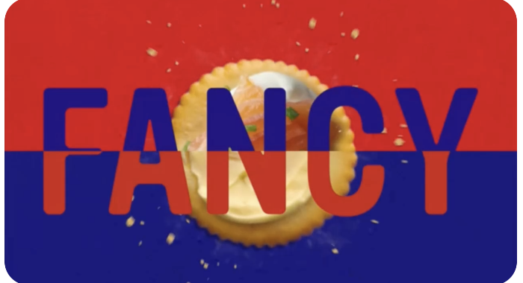
Creative guidance should be provided wherever possible
Working closely with our Mx and advertisers will be critical to ensure the success of ads on the DoorDash platform.
Ads should feel more authentic vs. “commercial”
Consider a “how to” approach
Keep motion “simpler”
•
•

Slide 18
How do Mx feel about ads?
Source material:
SMB/MM Ads and Promotion Adoption & Retention Discovery
More to come!

Slide 19
What are Mx's preferences and perceptions of our current A&P offerings?
[Audience] Target New Customers Exclusively: This was the most popular A&P segmentation regardless of whether the Mx had operational constraints or not.
[Ad] Sponsored Listings: Useful for Mx who believe they lack regular visibility on the app, particularly during high tourism seasons, providing exposure without needing discounts or free food.
[Promo] Free Item Offers (BOGO or Minimum Spend): Effective for Mx who control product prices and can offer items that cost less to produce. (E.g. offering a free cheese pizza with a higher minimum spend increased average customer spend with minimal cost to the Mx.)
•
•

Slide 20
What marketing solutions are Mx adopting outside of DoorDash?
Reduced Commission Rate with Minimum A&P Spend: Mx were offered a lower commission rate by UberEats if they committed to a minimum monthly spend on A&P for a fixed period. This allowed them to visualize the impact of A&P on their business and continued spending on ads after the agreed period. After learning what works they’re planning on running the same type of A&P with DoorDash.
Ad-Spend Matching: Some platforms, like Uber Eats, offered to cover a portion of the A&P costs, such as picking up 50% of the cost or contributing to half the spend on promotional items. This made participation in such promotions financially attractive for Mx.
A&P Funding: UberEats also ran promos for free, which significantly increased order volumes when promotional emails were sent to customers. Mx noted a substantial uptick in orders following such campaigns.
•
•

